Slide 1
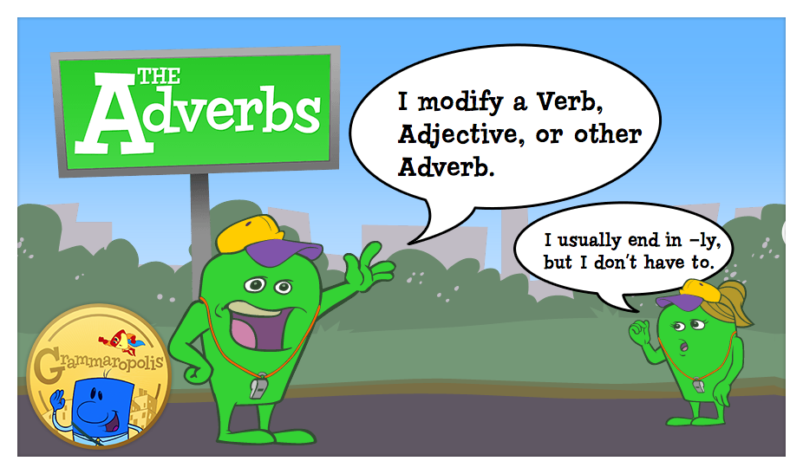

Slide 2
An adverb is a word that is used to modify
an adjective, a verb, and an adverb (not a noun).
Adverb modifying an adjective: Anahita is an incredibly smart student.
Adverb modifying a verb: Mohammad solves Math problems cleverly.
Adverb modifying an adverb: Last night, a man was chasing Ashkan to steal his smartphone. To save himself, he began to run unusually quickly.

Slide 3
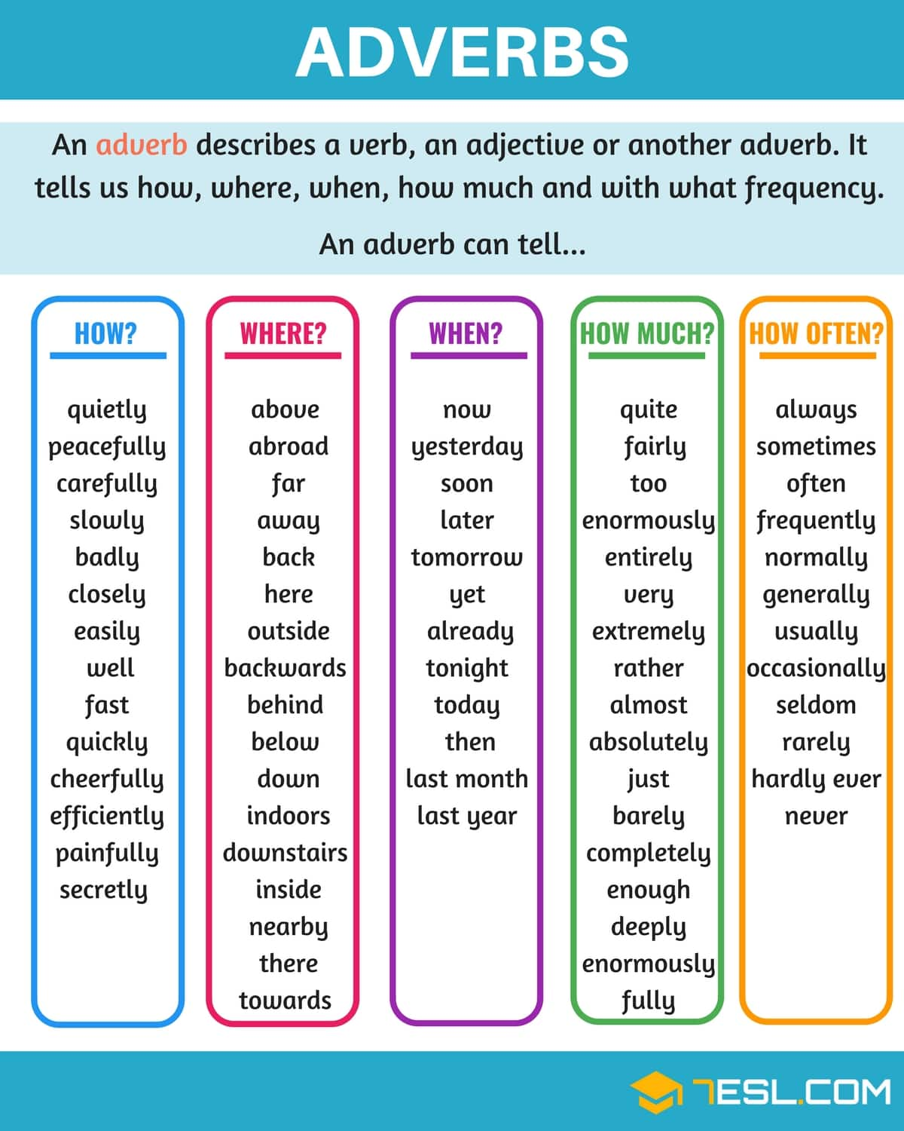

Adverb functions

Slide 4
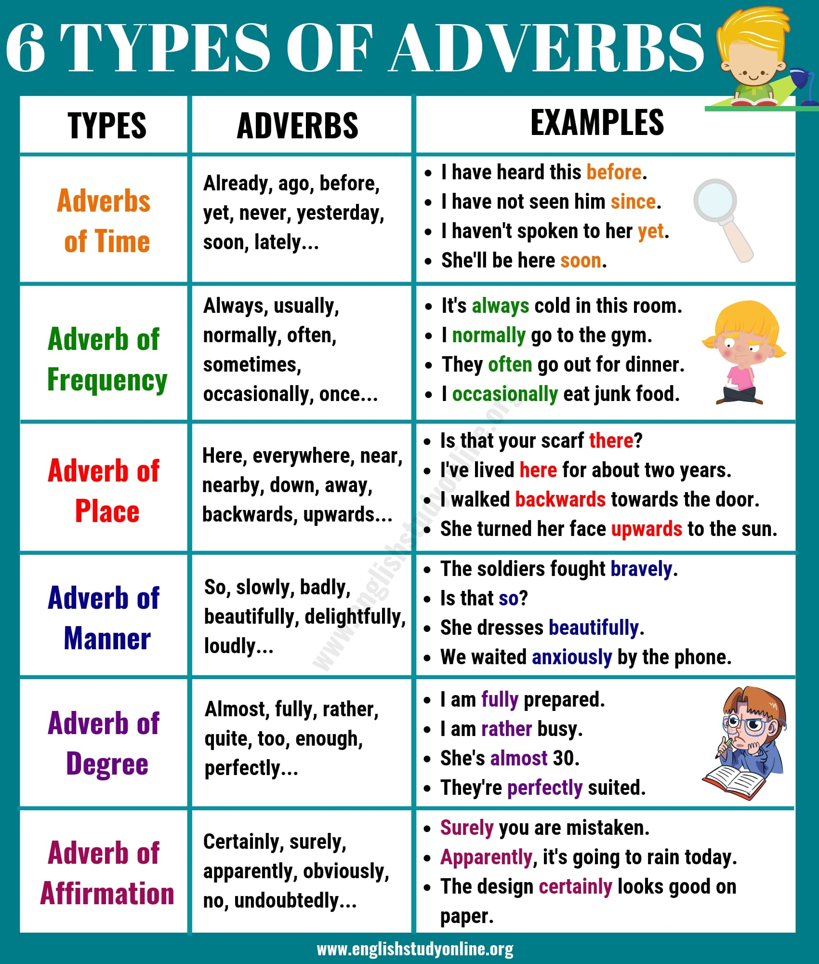

Slide 5
Where to Place Adverbs in the Sentence?
Adverbs of frequency
One verb in a sentence: Subject + adverb of frequency + main verb
Amir Reza always takes the bus to the university.
More than one verb in a sentence: Subject + auxiliary verb + adverb of frequency + main verb
Mahsa and Mobina have often lent their notebooks to the classmates.
In a negative sentence or in a question: Auxiliary verb + subject + adverb of frequency + main verb
Does Reza usually get up so late?

Slide 6

2. Adverbs of manner
Main verb + (object) + adverb of manner
The professor asked Hosein to send the assignments immediately.
For emphasis: Adverb of manner + main verb
Hadis quickly agreed to go to the store for milk.

Slide 7
3. Adverbs of place
Adverbs of place can be:
Directional: up, down, around, north
Refer to distances: nearby, far away
Indicate an object’s position: below, between, above, behind
Show movement in a particular direction: toward, forward, backward, homeward, westward, eastward, onward
Main verb + (object) + adverb of place:
After a long day at university, we headed homeward.

Slide 8
4. Adverbs of time
Adverbs of time: placed at the end of sentences:
I am sick of living in chaos, so I am going to clean my house tomorrow.
For emphasis, placed at the beginning of sentences:
Later, Hanieh sent an email to the professor.
When using more than one adverb of time in a sentence, use them in the following order:
(1) How long (2) How often (3) When
The nurse volunteered at the hospital (1) for three days (2) every month (3) last year.

Slide 9
5. Adverb of degree
Discussing the degree or intensity of an adjective, an action, or another adverb:
Placed before the word they are modifying:
This cake is absolutely wonderful.
To emphasize or strengthen the meaning of an adjective, use the adverbs very or really in front of the adjective you want to strengthen:
Those are some really hot potatoes.

Slide 10

Adverb construction:
Adjective: Noun + ly: Friend (noun) + ly = Friendly (adjective)
ghostly, motherly, costly, lovely, weekly
Adverb: Adjective + ly: Careful (adjective) + ly = Carefully (adverb)
eagerly, angrily, helpfully, strangely, diligently

Slide 11
There is a small group of adverbs which end in -ward(s) or -wise:
1. -wards: inwards, eastwards, upwards, downwards:
The doctor asked her to move her head upward but she couldn’t.
2. -wise: clockwise, lengthwise, likewise:
Turn the handle clockwise to start it.

Slide 12
An adverbial clause is a group of words that plays the role of an adverb:
The dogs started chasing my car once they saw it turn the corner.
Adverb of time
After having my wisdom teeth out, I had a milkshake because I couldn’t chew anything.
Adverb of reason
We don't have conversations. You talk at me the way a teacher talks to a naughty student.
Adverb of manner
Anywhere the struggle is great, the level of ingenuity and inventiveness is high.
Adverb of place
Amir is as smart as he is tall.
Adverb of degree

Slide 13
